Slide 1
User Input
Notes:
Hi, in this video we’re going to learn how we can get input from a user to control commands in our code.

Slide 2
Getting User Input
We can ask the user to enter a word, phrase, or number that we can store in a variable to be used in our program.
variable_name = input(“Text prompt”)
Notes:
To write programs that give users the ability to interact with and control parts of our code, we can use the command ‘input’. To save the input that the user gave, we assign it to a variable.
We type the name of our variable followed by an equal sign. Instead of entering a value for the variable ourselves, we use the command input followed by a set of parentheses. Inside the parentheses, we write the text prompt that we want our users to see inside quotation marks.

Slide 3

Using User Input
Notes:
In this code, we are asking the user to determine what color our circle should be. We’ve named the variable ‘color_choice’ and are asking the question “What color should the circle be?”. We are then using this variable’s value to assign a color to Tracy before she draws the circle.
Just a quick side note- we’re using the variable name color_choice instead of just color because color is a reserved word in Python so it cannot be used as a variable name. Because there is already a command using the word color, we need to choose something else for our variable.

Slide 4
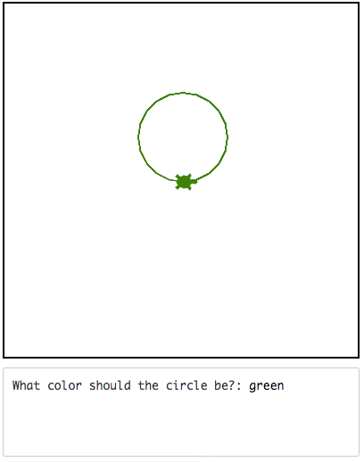
Using User Input
The word(s) that the user enters becomes the argument for the color command.
(In this case, green!)
Notes:
When we run this code, the user will see the text prompt and will be able to type in an answer. The user’s answer of ‘green’ is given as an argument to the color command. Tracy then changes her color to green and draws the circle.

Slide 5
Changing User Input to a Number
We can ask the user to enter a word, phrase, or number but in order to use a number, we need to convert it to an integer, using the command int().
variable_name = int(input(“Text prompt”))
Notes:
If we try to use the input command to get a number from the user and use it as a number in our code, Tracy will give us an error. This is because Tracy reads everything a user enters as a word by default. It’s very simple to change a user’s input to be read as a number by using the command int. All we need to do is surround our entire input command by the term int and place parentheses around it. You’ll notice two closed parentheses at the end of the phrase. This is because we opened two parentheses throughout our phrase so we need to make sure to close both of them or Tracy will respond with an error.

Slide 6

Using User Input
We can alter the variable throughout our code!
Notes:
In this code, we want the user to tell us what the radius of the circle should be so we ask the question “What is the circle’s radius?” and surround it with both the input and int commands.
(Click for label, arrow, and red box) You also may notice that we’re changing the value of the user input in the forward command. We can alter user input just as we would a variable’s value!

Slide 7
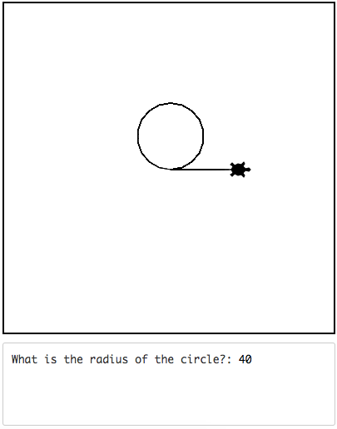
Using User Input
The number that the user enters becomes the radius of the circle
(In this case, 40!)
Notes:
The output of our code is a circle with a radius that was specified by the user. Tracy then moves forward the diameter of the circle. Let’s take a look at how we can use user input in Tracy programs.

Slide 8
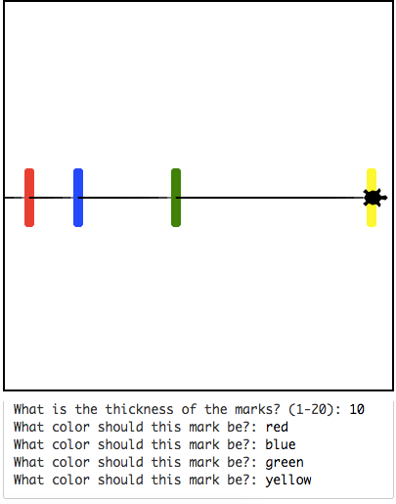
Example #1: Color Coded Increasing Length
Write a program that has Tracy draw a line with hash marks at 25, 50, 100, and 200 pixels.
The thickness of the marks should be provided by the user
Each mark should be colored based on user input
Notes:
In this example, we want Tracy to draw the same line with hash marks as in the last lesson, but this time, we want to ask the user for the thickness of the marks and what color each mark should be.

Slide 9
Commands Learned this Lesson
Command | What does it do?
variable_name = input(“ “) | Saves user input
variable_name = int(“ “) | Changes a user’s answer to a number value
Notes:
In this lesson, we learned how to get input from a user and how to change input from a word to a number. Refer to the examples we went through to help you collect user input to solve some Tracy challenges of your own!

